Slide 1
Basic Report Design
MUKESH KUMAR

Slide 2
AGENDA
Visual Types
Canvas
Table/Tree Map
Formatting
Legend/Category/Grid

Slide 3
Canvas Settings
Format > Canvas Settings
Format > Canvas Background

Slide 4
Scatter plot
Format > Grid lines
Format > Markers
Format > Category Label
Format > effects>Background
General > Title
General > Background
General > Data Format
General > Tooltip
Reset all setting
General

Slide 5
Histogram
To create a histogram in PowerBI we need to group the numerical column
Right click the column and create new group> select bins
This will create a new col which needs to be added on x-axis
X-axis
Data labels
Legend

Slide 6
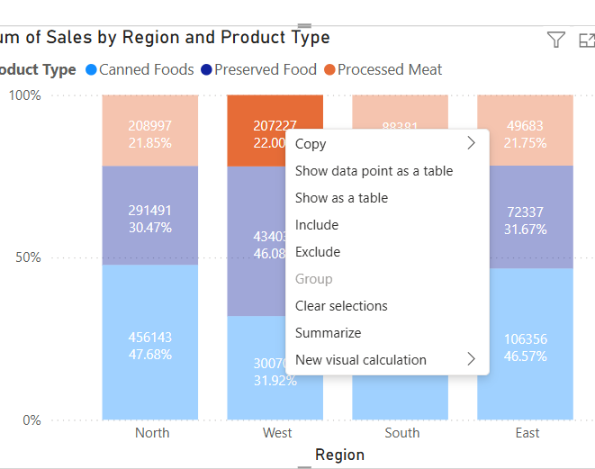
Stacked bar plot
Export as CSV

Slide 7
Pie char
Donut char
Map

